Slide 1
Jermyn Borough Council Meeting
3/19/2026

Slide 2
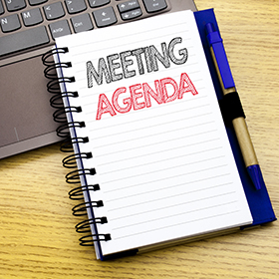
Meeting Agenda
MARCH 19, 2026
CALL TO ORDER
PLEDGE OF ALLEGIANCE
ROLL CALL
PREVIOUS MEETING MINUTES
TREASURE REPORT/BILLS PAYABLE
CORRESPONDENCE
SECRETARY REPORT
PUBLIC COMMENT
NORLACK RESOLUTION
PROFESSIONAL REPORTS
COMMITTEE REPORTS
INTERMUNICIPAL AGREEMENT
LRSB SUPPORT LETTER
250 CELEBRATIONS
POLICE VEHICLE
SPRING PAVING
ZONING ORDINANCE REVISION DISCUSSION
EXECUTIVE SESSION FOR LEGAL AND PERSONNEL ISSUES
NEW BUSINESS
ADJOURNMENT

Slide 3
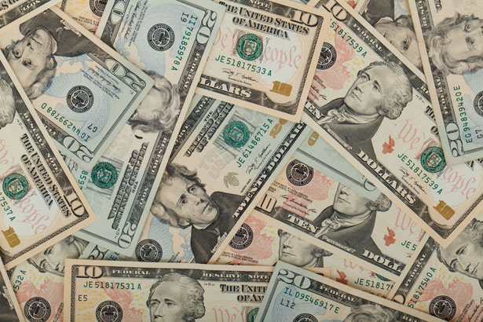
Treasurer’s report
3/19/2026
ASSETS
Checking/Savings
American Rescue Plan Fund 92,610.22
Capital Reserve - DPW 1,275.21
Capital Reserve - Police 5,129.82
Crime Watch Fund 222.69
General Fund - Community 46,692.45
General Fund - FNB 2,280.61
Holiday Lights Fund 400.59

Slide 4
Treasurer’s report
Investment - General Fund 1,180.68
Investment - Liquid Fuels 25,998.43
Investment - Paving Fund 1,192.93
Investment - Recycling 129.92
Investment - Refuse 185.98
Liquid Fuels - FNB 54,033.17
Petty Cash 194.00
Recreations Fund 22,819.81
Recycling - Community 10,141.26
Refuse Checking - FNB 48,354.49
Total Checking/Savings 312,842.26

Slide 5
Treasurer’s report
200000 · Accounts Payable 786.13
Long Term Debt 0

Slide 6


